Slide 1

TS Security Solutions: Governance, Risk, and Compliance (GRC) Portfolio
A Real world GRC strategy approach backed by policy, risk, and compliance expertise

Slide 2
About Terious Stephens & TS Security Solutions
Terious Stephens
IT Professional with 15 years of experience in IT
Specializes in support, systems administration, data management, and information security
Strengths: Security documentation, risk assessment, control mapping, GRC frameworks, policy creation
TS Security Solutions
Sample cybersecurity consulting and documentation firm that specializes in creating actionable GRC strategies for small to mid-sized organizations.
The mission of the company is to deliver scalable, compliant, and secure solutions through clear policy, risk insights, and incident preparedness.

Slide 3
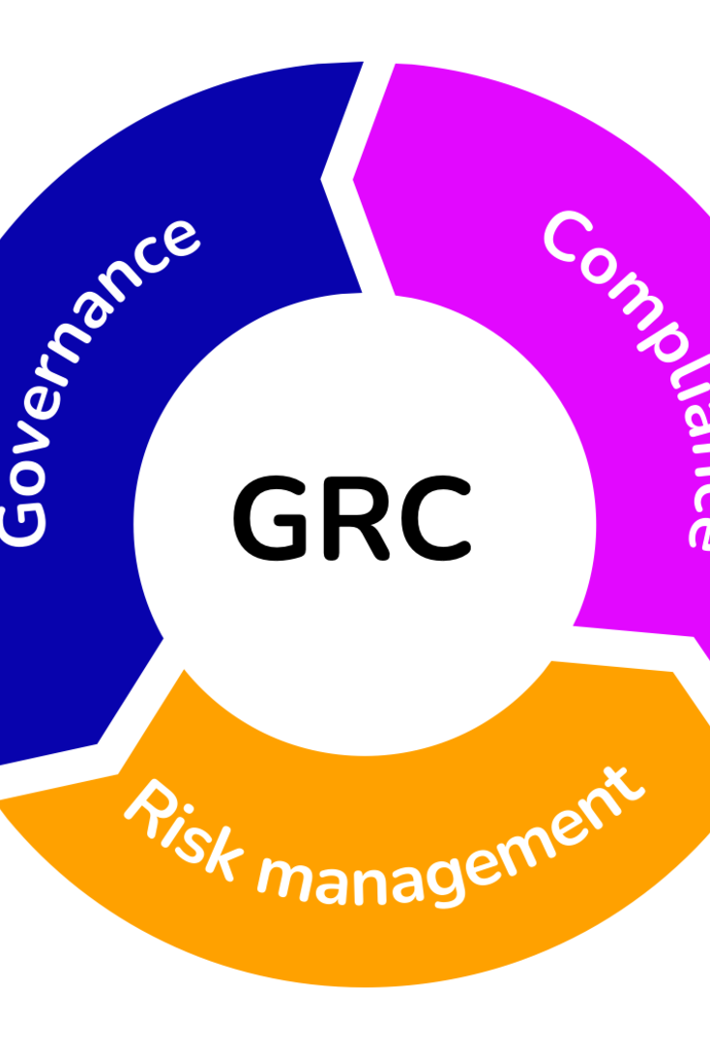
GRC Deliverables Overview
Acceptable Use Policy – Establishes safe and responsible user behavior
Information Classification and Management Policy – Defines data sensitivity tiers and handling
Risk Management Policy – Outlines TS Security Solutions’ approach to enterprise risk
Risk Assessment Report – A practical evaluation of threats, vulnerabilities, and control gaps
Incident Response Plan – Provides structure for fast, effective response to security events
Data Retention and Disposal Policy – Aligns data lifecycle with compliance and security needs
Risk Scenario: SecureMail Gateway Assessment (sample assessment) – A use-case applying real controls to a simulated client system

Slide 4

Risk Management Approach
At TS Security Solutions, we believe risk should be both visible and actionable. Our approach begins with stakeholder interviews and ends with an updated, prioritized risk register.
Methodology includes qualitative analysis, likelihood and impact scoring, and alignment with NIST SP 800-30 and 800-53 controls.
Risks are not just documented, they’re scored, tracked, and assigned mitigation steps.
Deliverables include a matrix view of risks, scoring tables, and mapped NIST control IDs for every finding.

Slide 5
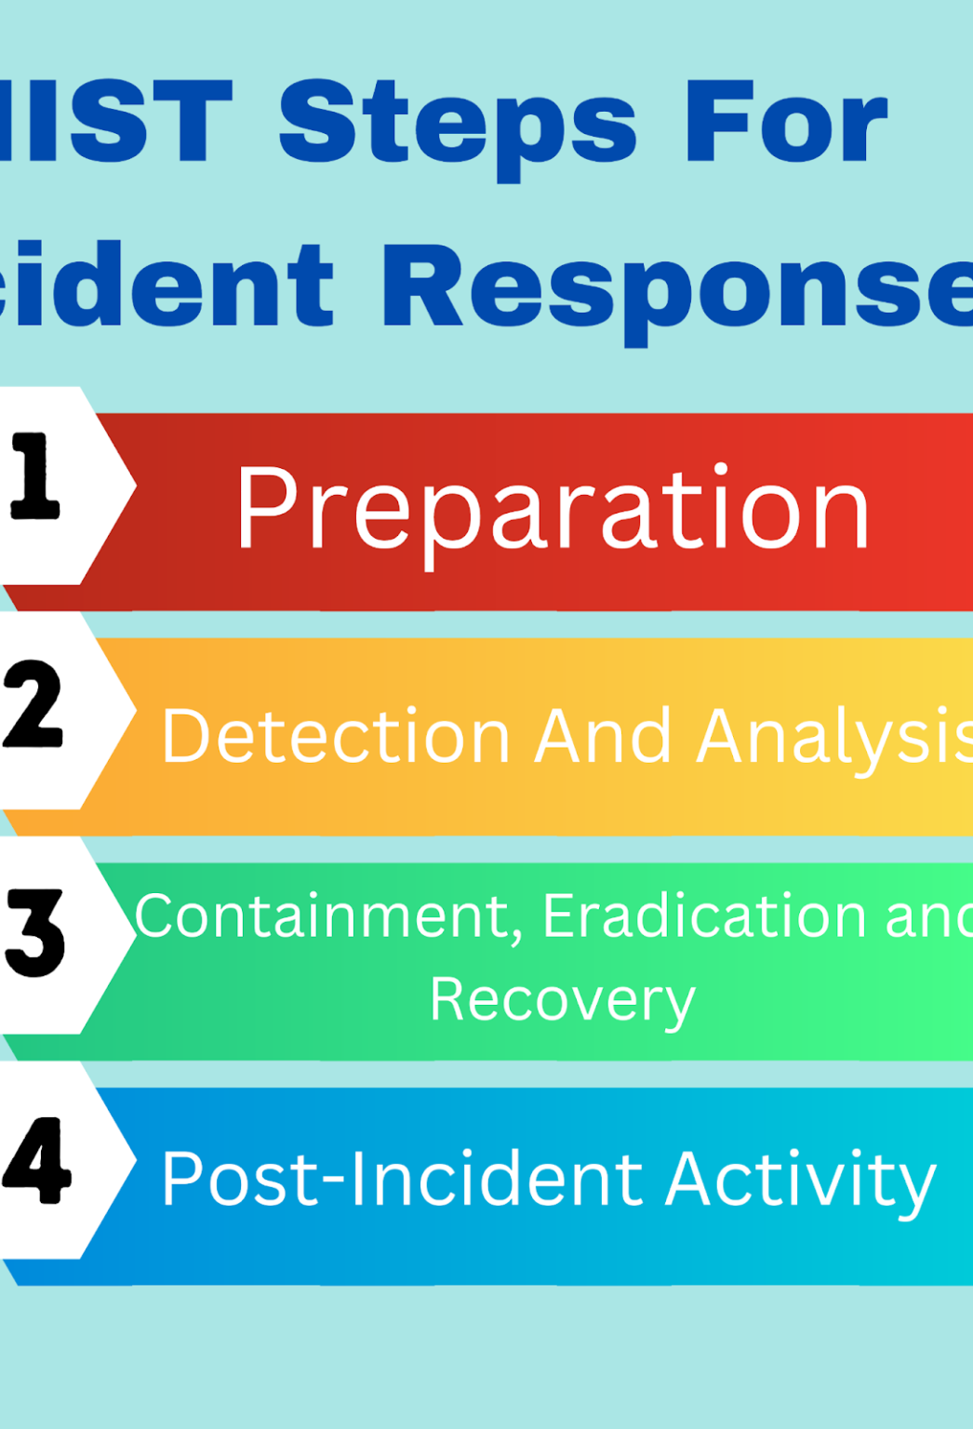
Incident Response Framework
Cyber incidents are inevitable, and chaos is not. Our Incident Response Plan, or IRP, follows a structured, actionable lifecycle:
Preparation: Building playbooks and identifying roles
Detection and Analysis: Triage, validate, assess scope
Containment: Short and long-term containment actions
Eradication and Recovery: Clean the system, restore backups and close vulnerabilities
Lessons Learned: Conduct post-mortem, update documentation, train staff
This IRP is mapped to NIST SP 800-61 Rev. 2 and written with small security teams in mind, with it being easy to scale and fast to follow.

Slide 6

Data Classification & Retention Policy
Handling sensitive data starts with labeling it properly and ends with disposing of it securely.
Classification levels: Pubic, Internal, Confidential, and Restricted
Each data type is tied to specific handling rules and retention timelines
Retention periods were designed around regulatory requirements, namely PCI and HIPAA, and practical storage policies
Disposal follows NIST SP 800-88, using digital shredding or hardware destruction procedures depending on sensitivity level
This policy ensures organizations don’t just store data securely, they get rid of it correctly as well.
This Photo by Unknown Author is licensed under CC BY-SA

Slide 7

Scenario Summary – SecureMail Gateway (sample)
The SecureMail Gateway sample assessment illustrates the methodology that TS Security Solutions uses, in action.
Objective: Evaluate a secure email system for risks related to encryption, access control, and monitoring
Findings:
Lack of encryption at rest
No centralized logging or SIEM integration
Weak user provisioning processes
Recommendations:
Enables AES-265 encryption
Centralize logs and alerting
Apply role-based access controls and conduct periodic reviews
Outcome: Risks categorized, mitigation prioritized, and controls mapped to NIST (AC-2, AU-6, SC-12)
This write-up helps bridge the gap between theory and the day-to day reality of GRC consulting.

Slide 8
Compliance & Framework Mapping
Document/Policy | NIST 800-53 | ISO 27001 | HIPAA Compliant | PCI DSS
Acceptable Use Policy | AC-1, PL-4 | A.6, A.7 | ✅ | Req 12
Information Classification Policy | MP-5, SC-12 | A.8 | ✅ | Req 3
Risk Management Policy & Report | RA-1 to RA-5 | A.15 | ✅ | Req 12
Incident Response Plan | IR-1 to IR-8 | A.16 | ✅ | Req 12
Data Retention & Disposal Policy | MP-6, SI-12 | A.11 | ✅ | Req 9
Risk Scenario (SecureMail) | Control Mapped | A.17 | ✅ | ✅

Slide 9

What Makes Me a Candidate?
I bring more than just years of IT experience. I bring heart, perspective, and a grounded understanding of how governance, risk, compliance, and information systems come together to protect what matters most. Throughout my career, I’ve seen firsthand how the right controls and the right mindset can make or break an organization’s future.
This work isn’t just technical to me, it’s very personal. I treat every company’s data, name, and people like they were my own. That means building frameworks that are usable, reliable, and accountable. Whether I’m crafting a policy or evaluating a system, I aim to bring clarity, calm, and confidence to every GRC initiative I touch.
Protecting people and businesses through better information systems is the mission I show up for every day.

Slide 10
My Contact Info
Email: teriousstephens@gmail.com
LinkedIn: https://www.linkedin.com/in/terious
Phone: 404.819.4385
GitHub: https://github.com/tstep689

